Slide 1
Metadata Updates (for S-100 3.1+ / 4.0) S-100 WG TSM5 19-21 September 2017
Raphael Malyankar, Consultant, Portolan Sciences
Eivind Mong, Consultant
Work performed under NOAA sponsorship

Slide 2
Overview
Implementation of proposals accepted at S-100 WG2
Changes arising from S-104, S-111, S-122, S-123 experiences
New metadata elements arising from NPUB product specification development
Make vertical and sounding datums optional
Updates arising from new editions of ISO 19115: ISO 19115-1:2014 & 19115-3:2015
ISO 19115-1 and 19115-3 replace ISO 19115 & 19139
Terms, metadata element names, metadata classes
Metadata for services
Notes:
The proposals accepted at S-100 WG2 are described in the SPAWAR proposals for the WG2 meeting and the S-100 WG2 minutes.

Slide 3
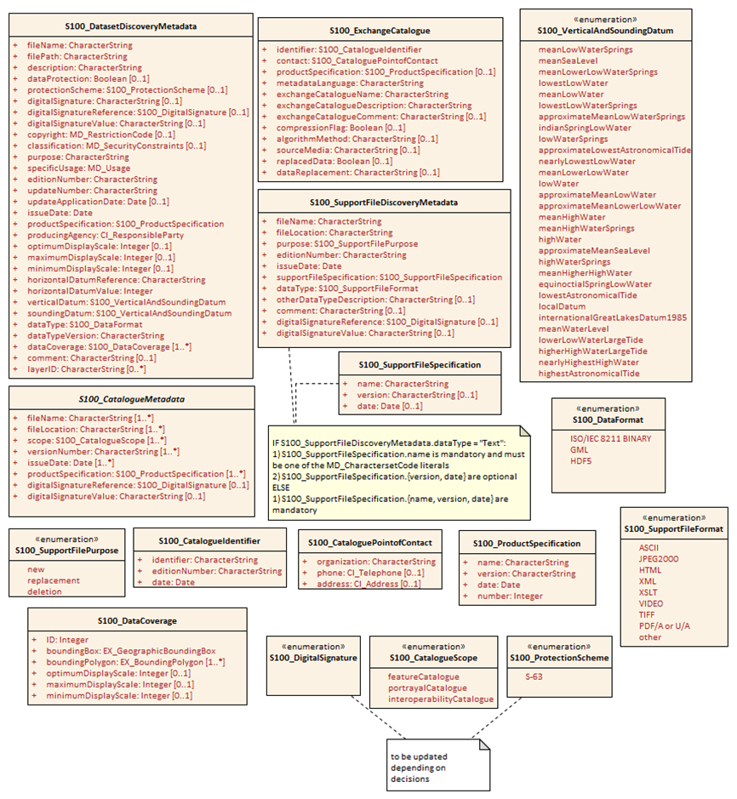
Figure 4a-D-4 updated
Notes:
‘interoperabilityCatalogue’ has been added to S100_CatalogueScope (see next slide) but otherwise this diagram is just the accepted changes

Slide 4
New proposed experience-based changes
Add XML to S100_DataFormat in Part 4a and Part 12 for interoperability.
Make vertical datum and sounding datum optional.
Add elements describing the metadata discovery resource.
Add a literal describing interoperability catalogue information to S100_CatalogueScope in order to describe interoperability catalogues.
Literals for the new enumerations agreed at S100WG2 need to be determined.
Redundant attribute digitalSignature in S100_DatasetDiscoveryMetadata should be removed and a “none” or “unsigned” literal added to S100_DigitalSignature; if digitalSignature is retained, its type should be Boolean.
Mandatory digital signature for catalogues in table (in text) should become optional like Figure 4a-D-4.
List of compression algorithms started for S100_exchangeCatalogue.algorithmMethod.
Notes:
1) S100 WG2 accepted a proposal to remove “other” from S100_DataFormat. That leaves nothing to describe interoperability information which is not in GML, HDF5, or ISO 8211 format.
2) Some data products e.g., S-122 (Marine protected areas), S-123 (Marine radio services), S-412 (Weather overlay), etc., do not have depth, elevation or height thematic attributes and therefore vertical datum and sounding datum are not relevant to those datasets.
3) Deriving from S-122: MetadataFileIdentifier and the other elements proposed to be added describe the metadata resource itself. The names, types and multiplicities are:
metadataFileIdentifier 1 CharacterString
metadataPointOfContact 1 CI_ResponsibleParty
metadataDateStamp 1 Date
metadataLanguage 1..* CharacterString
4) A new literal in S100_CatalogueScope is needed for interoperability catalogues.
Proposed literal: interoperabilityCatalogue
Definition: “S-100 interoperability information”
5) New enumerations S100_DigitalSignature, S100_ProtectionScheme were agreed at S100WG2, literals TBD.
6) S100_DatasetDiscoveryMetadata attributes digitalSignature, digitalSignatureValue: Redundancy and/or improper type. Both are character strings. In fact the presence of the co-attribute digitalSignatureReference can be used to determine whether the dataset is signed: If it is absent the dataset is not signed, if it is present, the dataset is signed. digitalSignature should be deleted. If retained, it should be a Boolean.
7) Catalogue signatures need not always be mandatory.
8) S100_exchangeCatalogue.algorithmMethod: Agreed in principle at S100WG2 to make this an enumeration, list of algorithms is requested.

Slide 5
Changes related to new version of ISO 19115

Slide 6
ISO 19115 changes
Part No. | Section No. | Proposal Summary
4a | 2.2 | Note about backwards compatibility
4a | various | Miscellaneous changes to terminology and/or semantics of metadata elements or attributes: fileIdentifier -> metadataIdentifier hierarchyLevel -> resourceType core metadata -> recommended metadata etc., etc.
4a | various | PT_Locale used for localisation, grouping language and characterset attributes
4a | various | Updated types for information about organizations and individuals; this is used for citation of responsible parties and contact information
4a | 5.4 | various changes minimum metadata requirements
4a | 5.5 | miscellaneous changes to recommended metadata for geographic datasets
4a | 5.6.5 | Minor changes to specification of extensions
4a | 5.7 | New section on metadata for service discovery
App. 4a-A | 4a-A-2 | New diagram for service metadata classes
App. 4a-D | Figure 4a-D-4 | Updated to reflect use of defaultLocale and otherLocale (type PT_Locale) for localisation of information
App. 4a-D | Figure 4a-D-5 | New table for service identification metadata

Slide 7
Examples of terminology update effects
Table 4a-1 Minimum metadata for geographic datasets
Name | Path | Datasets | Other resources
Metadata file identifier | MD_Metadata.metadataIdentifier > MD_Identifier.code | M | M
Metadata language | MD_Metadata.defaultLocale > PT_Locale.language | C ( documented if not defined by the encoding process) | C (same as for dataset)
Metadata character set | MD_Metadata.defaultLocale > PT_Locale.characterEncoding | C (documented if ISO 10646-1, is not used and not defined by the encoding process) | C (same as for dataset)
Metadata file parent identifier | MD_Metadata.parentMetadata > CI_Citation.identifier | C (documented if the hierarchy of a higher level exists) | C (same as for dataset)
Party responsible for the metadata information | MD_Metadata.contact > CI_Responsibility.CI_Individual (table 4a-2) or MD_Metadata.contact > CI_Responsibility.CI_Organization (table 4a-3) | M (either organization or individual must be documented) | M (same as for dataset)
Date(s) associated with the metadata | MD_Metadata.dateInfo > CI_Date | M (creation date required, other dates may be provided) | M (same as for dataset)
Resource default language | MD_Metadata.identificationInfo > MD_DataIdentification.defaultLocale > PT_Locale.language | M | C (only used if MD_DataIdentification has been used)
Resource default character set | MD_Metadata.identificationInfo > MD_DataIdentification.defaultLocale > PT_Local.characterEncoding | C (documented if UTF-8 is not used) | C (documented if UTF-8 is not used)
Name of the scope/type of resource for which the metadata is provided | MD_Metadata.metadataScope > MD_MetadataScope.resourceScope > MD_ScopeCode (codelist – ISO 19115-1) | M (default = “dataset”) | M
Description of scope of resource for which the metadata is provided | MD_Metadata.metadataScope > MD_MetadataScope.name | O | O

Slide 8
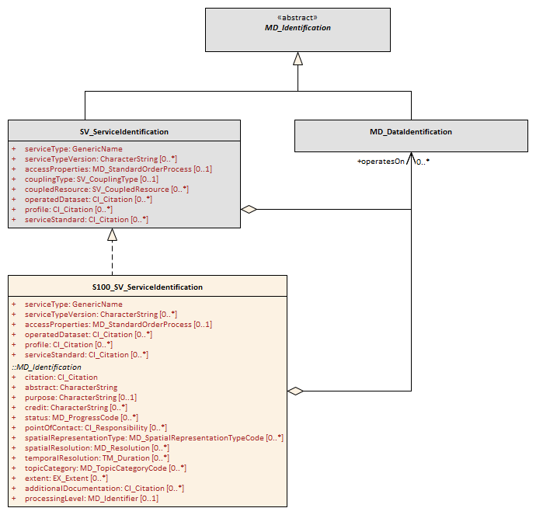
New service metadata class in relation to ISO classes

Slide 9
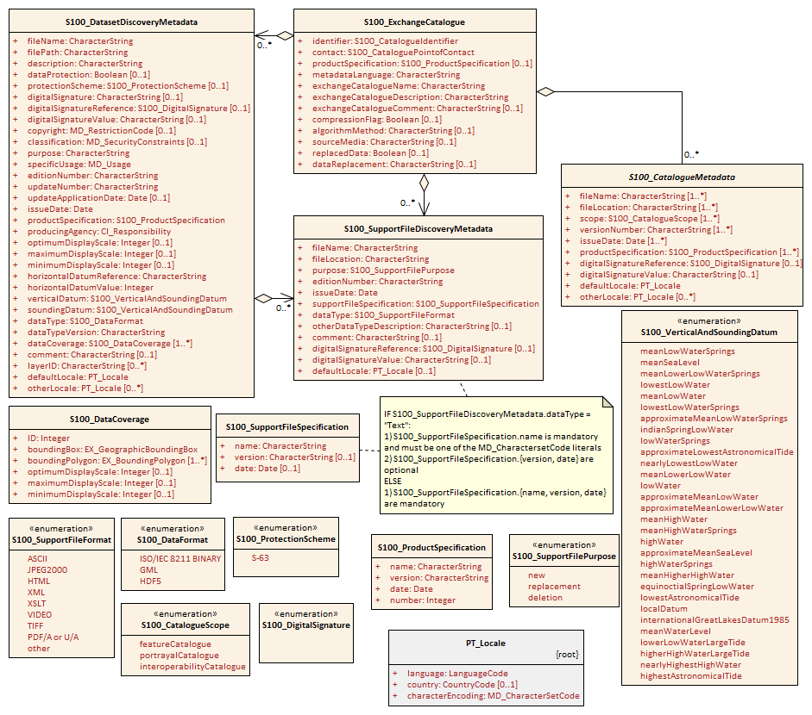
Re-drawn Figure 4a-D-4 showing relationships

Slide 10
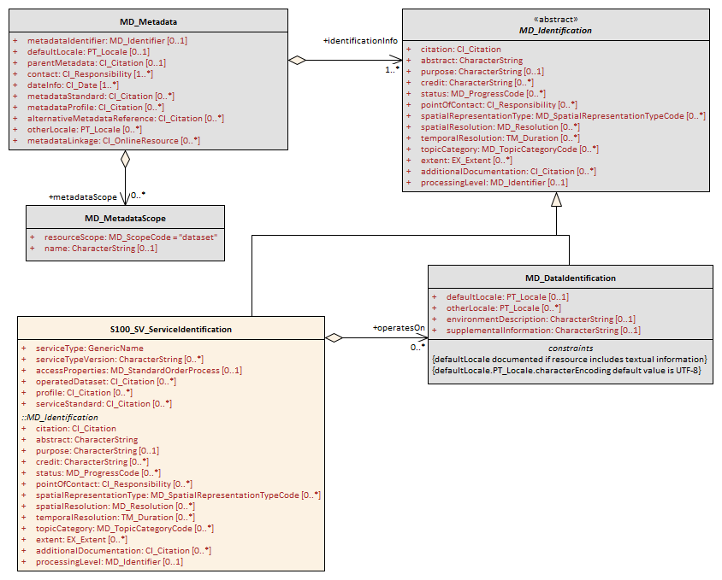
Proposed discovery metadata for services
‘Service discovery metadata’ is analogous to the current discovery metadata, but for services

